Slide 1
AOTA
Asteroidal Occultation Time Analyser

Slide 2
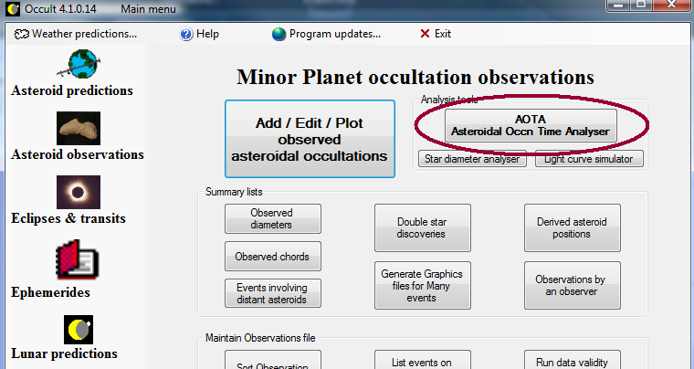
AOTA is in Occult 4.1.0.14

Slide 3
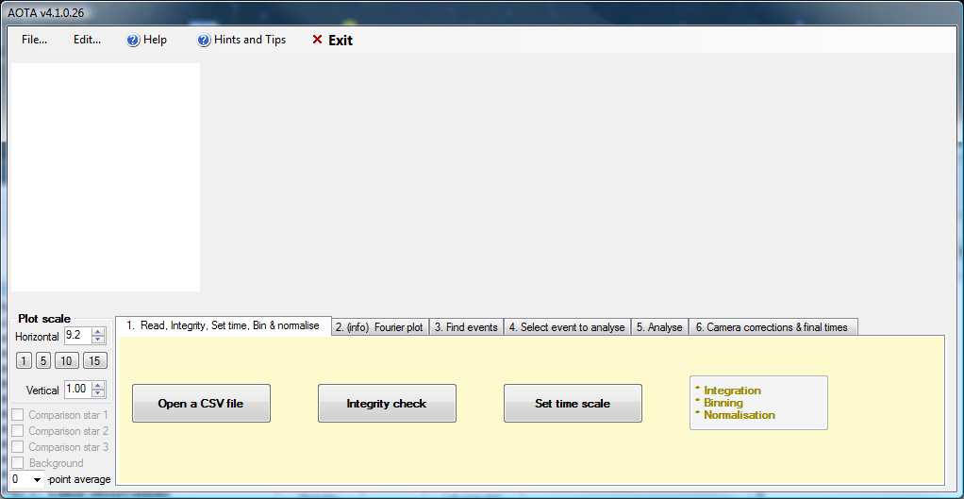
and looks like:

Slide 4
Aim
Create an alternative tool to analyse asteroidal occultation light curves
Focus on measuring the D and R events independently
Handle Limovie & Tangra files
Handle output from integrating cameras
Clear presentation of what is ‘going on’
User friendliness & simplicity – as much as possible!

Slide 5
Basic methodology
Integrity check, for timing inconsistencies
Putative events identified using cross-correlation analysis
D and R events analysed by fitting a test light curve of varying transition duration, using a χ² best fit analysis
Uncertainties determined using a Monte Carlo analysis, with noise applied to the test light curve
Apply camera-based corrections to the times

Slide 6
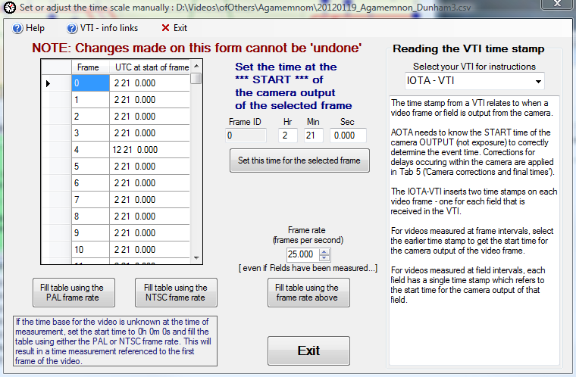
If no time stamps, set manually

Slide 7
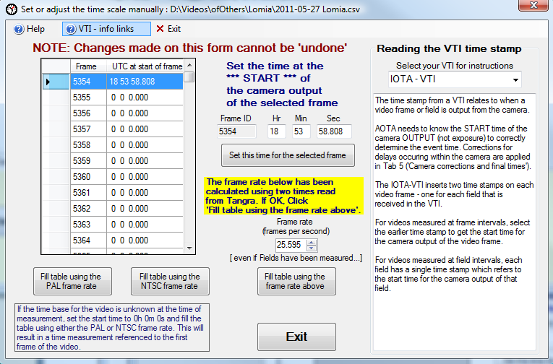
If start and end time stamps, can fill with calculated rate. But treat with care

Slide 8
Integrity Check
Highly desirable to have OCR reading of time stamp
Looks for irregularities in time stamp sequence, and for identity in sequential measurements
For integrating cameras, checks that the recorded #frames in each integration interval is constant

Slide 9
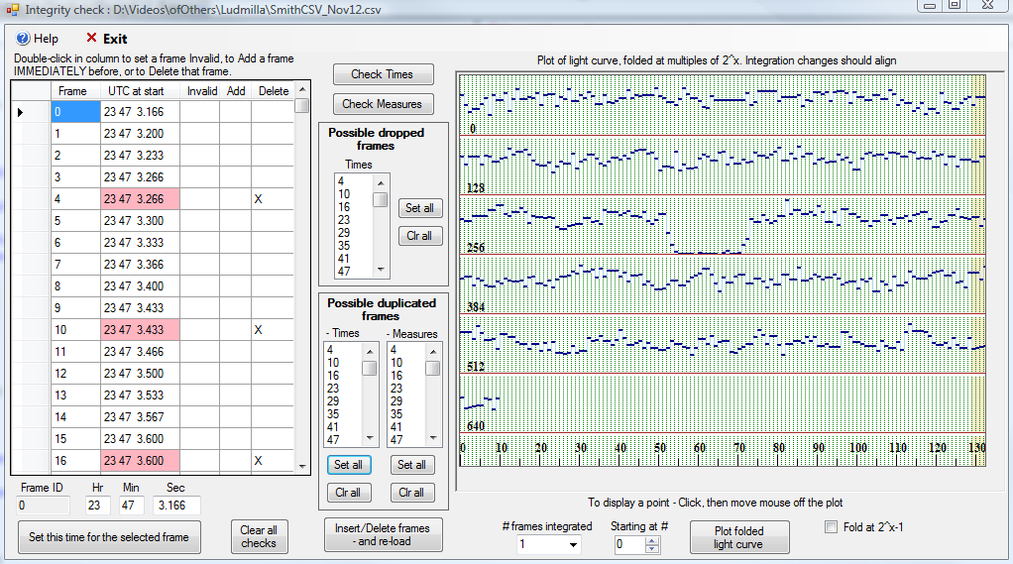
Example video with duplicated frames

Slide 10
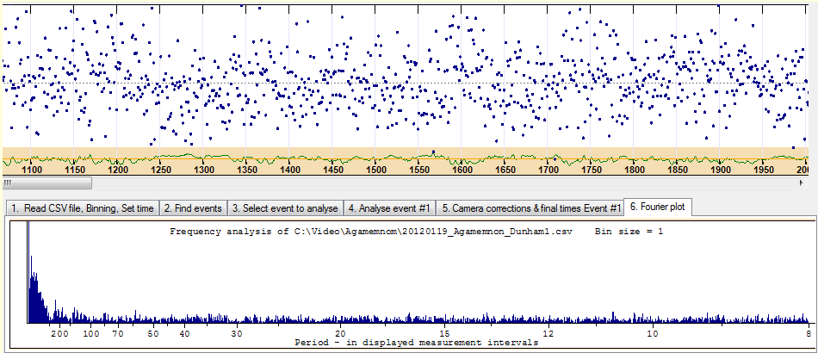
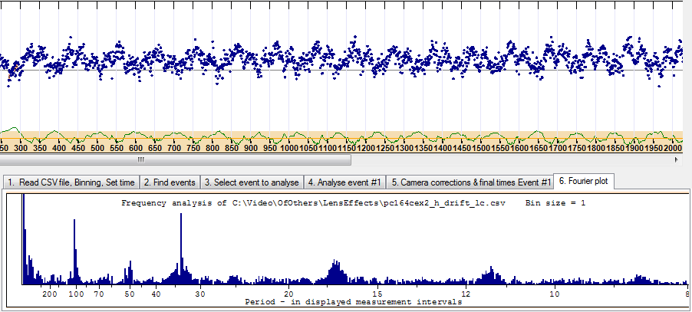
Can check for systematic problems with a Fourier Analysis plot
Good
Bad

Slide 11
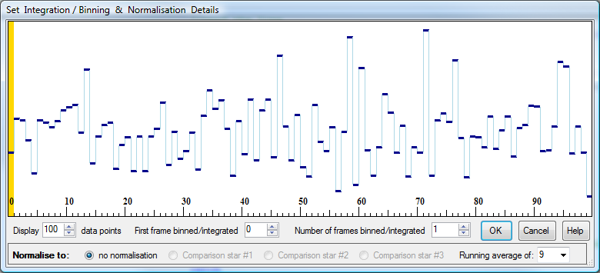
Set integration/binning/normalisation

Slide 12
Event identification
Test signal extends for the entire recording duration
Sets a minimum cross-correlation level for a possible event
Look for symmetric triangle, straight sides, sharp apex, peak above orange region at bottom, and light curve flat across the bottom.

Slide 13
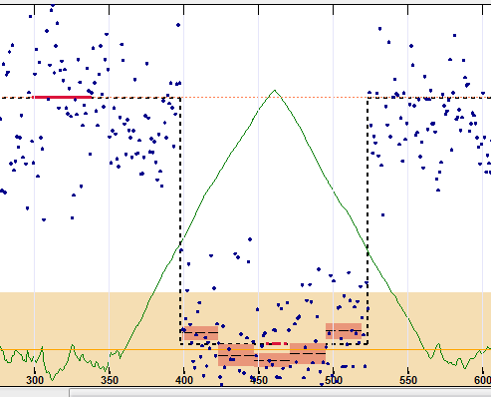
Symmetric triangle with straight sides, sharp apex, flat light curve at bottom (see 5 orange bars)

Slide 14
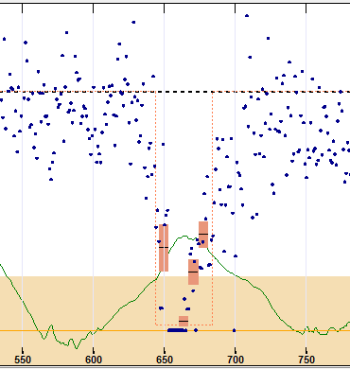
Cloud event – asymmetric, non-straight sides, no sharp apex, light curve at bottom not flat (see orange bars)

Slide 15
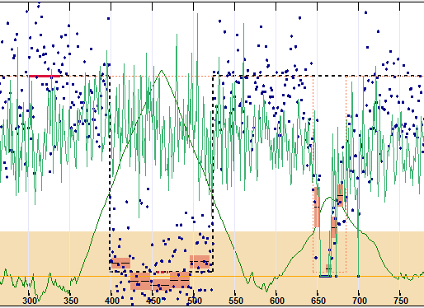
Can overlay comparison stars
Note how the green line drops at the same time as the cloud event, but not for the occultation

Slide 16
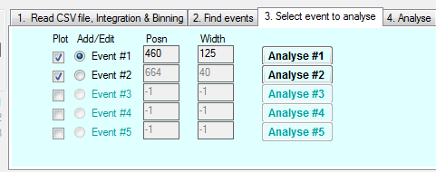
Can identify up to 5 putative events
Each event can be separately analysed

Slide 17
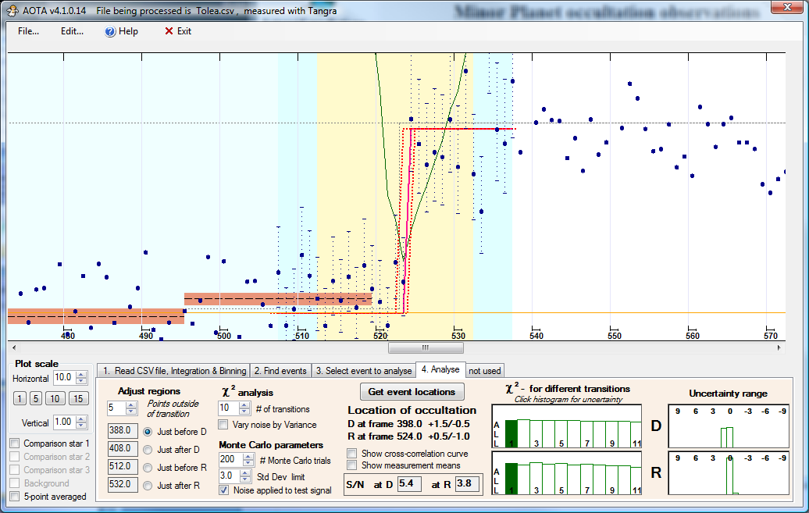
Final plot showing fitted light curve and uncertainties

Slide 18
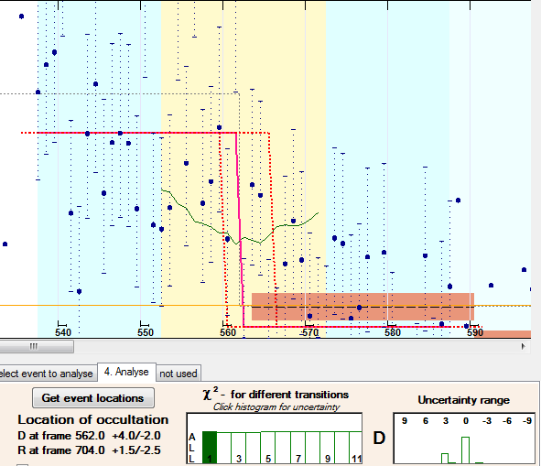
Some events have two discrete possibilities
Dunham-Agamemnon

Slide 19
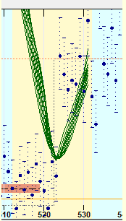
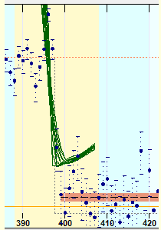
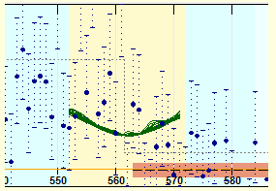
Accuracy visible via χ² curves
Well-defined event
Small uncertainty on the ‘-’ side, large on the ‘+’ side
Poorly-defined event

Slide 20
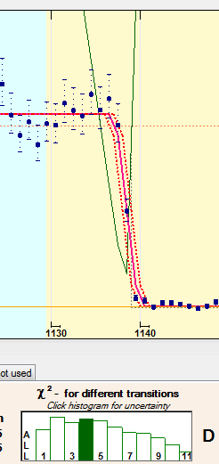
True gradual events have a rise and fall in the plot of χ²

Slide 21
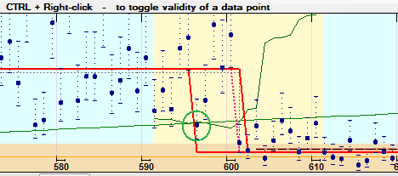
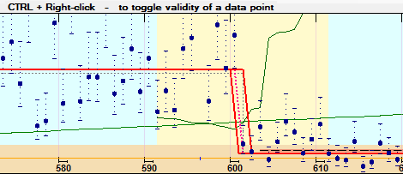
Disregard anomalous points

Slide 22
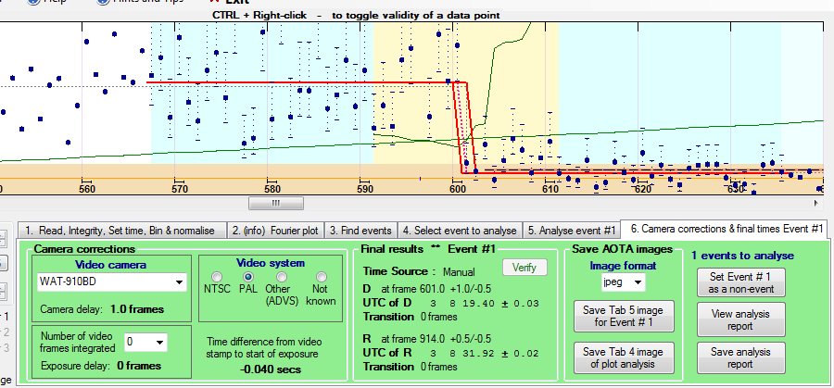
Applies corrections based on camera used

Slide 23
Can view/save measurement report
AOTA analysis of the file D:\Videos\ofOthers\Metis\20140307-Metis_Pierrefontaines.csv
- analysed on Wednesday, 26 March 2014 at 3:29 AM UTC
- using AOTA v4.1.0.27
Event #1
Event location in video frame ID's
D: 601.0 +1.0/-0.5
R: 914.0 +0.5/-0.5
Event time in UTC
D: 3 8 19.40 ± 0.03
R: 3 8 31.92 ± 0.02
Duration of transition in frames
D: 0
R: 0
SN at event locations
D: 3.0
R: 3.3
===== Camera details =====
Camera : WAT-910BD
Frames integrated : 0
Video system : PAL
==== Measurement info ====
Measurement tool : Limovie
Measured at Field level: False
# Measurements binned : 1
Normalisation : None
Time scale from tool : False
===== end of report ======

Slide 24
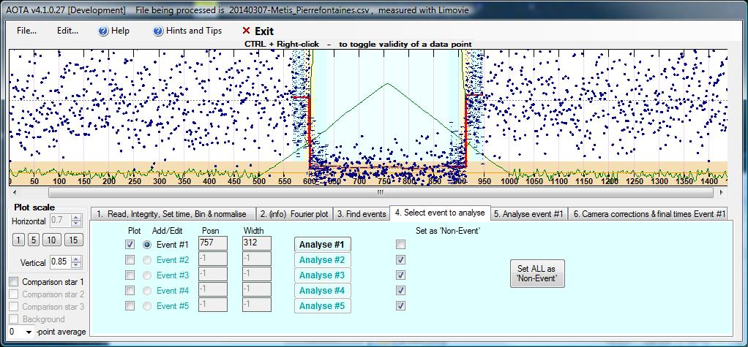
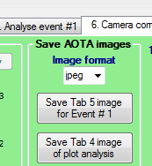
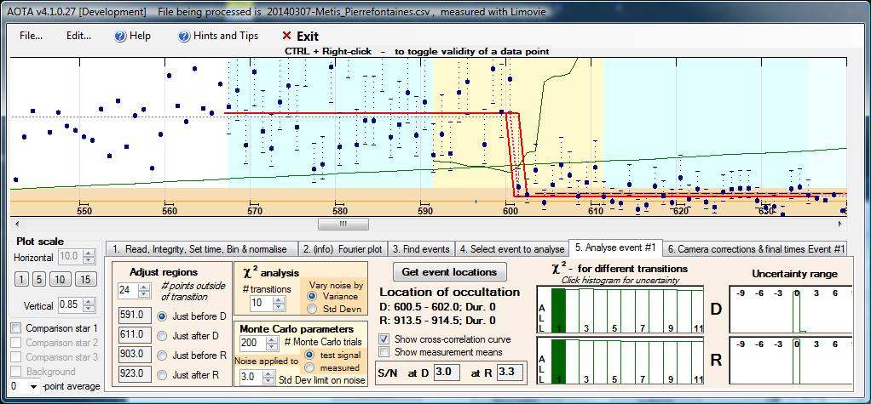
Save plots for sending to others

Slide 25
Detailed Help file provided, with step-by-step instructions and guidance on interpretation

Slide 26
Questions?

